Slide 1
Big Mountain resort
Proposal on pricing strategy based on empirical data

Slide 2
Problem identification
Big Mountain resort has access to 105 trails, serviced by 11 lifts, 2 T-bars, and 1 magic carpet for novice skiers. The longest run is 3.3 miles in length. The base elevation is 4,464 ft, and the summit is 6,817 ft with a vertical drop of 2,353 ft.
In addition, an additional chair lift has been installed recently to help increase the distribution of visitors across the mountain. This additional chair increases their operating costs by $1,540,000 this season.
The pricing strategy has been to charge a premium above the average price of resorts in its market segment. However, this comes with certain limitations, especially since it is not obvious how important some facilities are compared to others and whether it can be further capitalized.
How can Big Mountain resort select a better value for their ticket price? And would any of the planned changes cut costs without undermining the ticket price or support an even higher ticket price?

Slide 3
Problem identification
Current ticket price Big Mountain resort is charging for Adults is $81 for both weekdays and weekends, no difference.
Big Mountain Resort has been reviewing potential scenarios for either cutting costs or increasing revenue (from ticket prices). The resort operates within a market where people pay more for certain facilities, and less for others. Being able to sense how facilities support a given ticket price is valuable business intelligence.
The business has shortlisted some options (on next slides presented as Scenarios):
Permanently closing down up to 10 of the least used runs. This doesn't impact any other resort statistics.
Increase the vertical drop by adding a run to a point 150 feet lower down but requiring the installation of an additional chair lift to bring skiers back up, without additional snow making coverage
Same as number 2, but adding 2 acres of snow making cover
Increase the longest run by 0.2 mile to boast 3.5 miles length, requiring an additional snow making coverage of 4 acres
The expected number of visitors over the season is 350,000 and, on average, visitors ski for five days.

Slide 4
Recommendation and key findings
The implemented model suggests that the resort should charge $95.87. Even with the expected mean absolute error of the model’s suggested price of $10.39, Big Mountain resort should definitely charge more than currently.
Big Mountain resort stands very high up on the board for all the most important features for visitors, which also supports the price increase. More on the most important features on next slides.
In regards to the possible changes, the two that could be considered:
Closing 10 runs will lead to huge drop in price. However, closing one run makes no difference in price, so if maintenance of runs is costly, closing one run can be considered.
Nevertheless, even better outcome is if Big Mountain is to add a run, increase the vertical drop by 150 feet, and install an additional chair lift, this would increase the price by $1.99, and over the season, this could be expected to amount to $3.474.638. Important to keep in mind that we are missing operational costs to be able to compare price increase to costs to run this!

Slide 5
Modelling and results
Our target feature for modelling was Adult Weekend ticket price.
First and foremost, it was tested whether average price would be good indicator. R squared which explains how one variable explains another (in our case how well average price explains Adult weekend ticket price) was 0, confirming that it is not a good approach to use average price. Also, it would be off by around 19 dollars if ticket price is guessed based on an average of market prices.
Therefore, we decided to focus on how different features impact the price. It was noticed that some have higher correlation with ticket price than others:
One of the most interesting ones is the area of snow making as visitors seem to value more guaranteed snow.
In addition, number of runs and total chairs are also quite well correlated with ticket price which also naturally leads to conclusion that the more runs you have, the more chairs you'd need to ferry people to them.
Additional features that impact the price greatly are vertical drop and number of fast quads especially considering the ratio with skiable area.

Slide 6
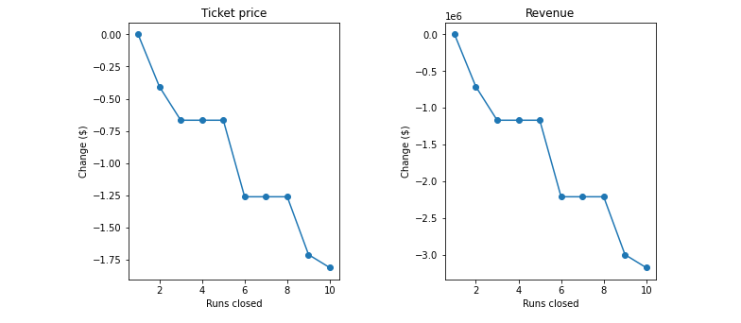
Scenario 1
Closing 10 runs will lead to huge drop in price. The model says that closing one run makes no difference in price, however everything else is dragging the ticket price down. If Big Mountain closes down 3 runs, it seems they may as well close down 4 or 5 as there's no further loss in ticket price. Increasing the closures down to 6 or more leads to a large drop.

Slide 7
Scenarios 2-4
Scenario 2: If Big Mountain is to add a run, increase the vertical drop by 150 feet, and install an additional chair lift, this would increase the price by $1.99, and over the season, this could be expected to amount to $3.474.638.
Scenario 3: If the resort is to add the same condition as in the previous one, plus 2 acres of snow making, the outcome would be the same as in Scenario 2 showing that adding 2 acres of snow making area makes no difference.
Scenario 4: If the longest run is increased by 0.2 miles and the snow coverage is guaranteed by adding 4 acres of snow making capability, there would be no difference to the price at all.
Recommendation is clearly Scenario 2 if the revenue is higher than operating costs (to be cross-checked)

Slide 8
Summary and conclusion
Pricing strategy should definitely be adjusted to reflect the learnings from this model as using market average is proven to be wrong.
Resort should consider implementing changes from Scenario 2 as this would lead to significant additional revenue in the long run.
How can the model be further improved? If there were operating costs included in the data (such as the costs for snow making or all the costs associated with maintenance of runs), it would further support the analysis, as well as the number of visitors in other resorts or within different states.
Also, the outcome of the modelling clearly shows that our resort is "undercharging", but it is important to highlight that this model assumes that other resorts accurately set their prices according to what the market supports. But if ours is mispricing itself, are others? However, if others correctly set their prices, it could be that our model is simply lacking some key data, such as data on operating costs.

